Slide 1


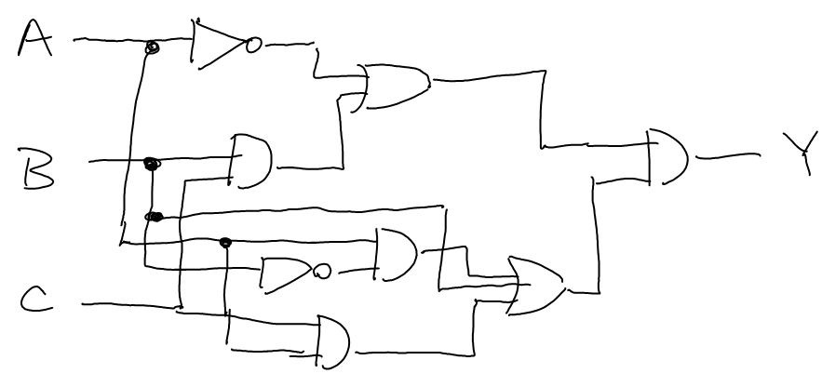
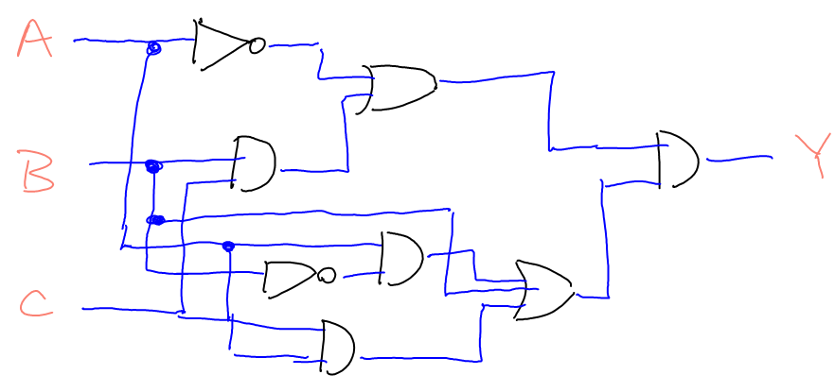



Recognizing and Labeling Hand-Drawn Sketches
James Brown, Eric Doi, Emily Fujimoto, Christine Alvarado
Background
Sketches are an intuitive form of visual expression for humans, but symbolic recognition of sketches is a difficult task for computers. In our system, we divide this task into several phases, two key components of which are the classification of individual pen strokes and the recognition of complete symbols. In the digital circuit domain, we have both reaching accuracies greater than 90%. However, we have yet to integrate these components into a fully-working system.
A perfect three-way classification (wire/gate/label)
Single-Stroke Labeling
Symbol Recognition
Single-stroke labeling entails the labeling of each stroke by observing its properties and its context in the sketch. In previous years, the team tried using a conditional random field (CRF) to partition strokes into wires, gates, and labels. After constructing the CRF, loopy belief propagation was used to approximate probabilities in the CRF, but the approximation yielded inaccurate and imprecise results. However, by using the junction tree algorithm to instead evaluate the probabilities exactly, we are able to reach a batch accuracy of 90.1%. Unfortunately, the algorithm slows dramatically with increased sketch complexity, and this may be a problem when attempting to process real-world sketches.
While humans have no difficulty recognizing the difference between an AND and an OR gate, the huge variability in drawing styles makes this a much more challenging task for computers. We make use of several different symbol recognizers to attempt to solve this problem. The most successful of these is the image-based “congealing” recognizer, which performs a guided search over the space of affine transforms to generate average images, then uses those average images combined with a custom image distance metric to classify target shapes. This recognizer can attain over 98% recognition on select gate classes.
NSF Career Grant (IIS-0546809)
The Congealer finding the average image for a group of XOR gates

